Slide 1


window latch
DATA SECURITY SOLUTION APPLIED TO IoT
Bruno Augusto
Matheus Ancelmo
João Calmon
Graziele Brustolom

Slide 2

Why?
IoT devices are in the internet, so they are exposed to all kinds of attacks
Some implementations could be critical like:
access systems
monitoring systems

Slide 3

What ?
Full Software solution
A security system based in the 4 Principles of the data Security
Confidentiality
Integrity
Authentication
Non-repudiation

Slide 4
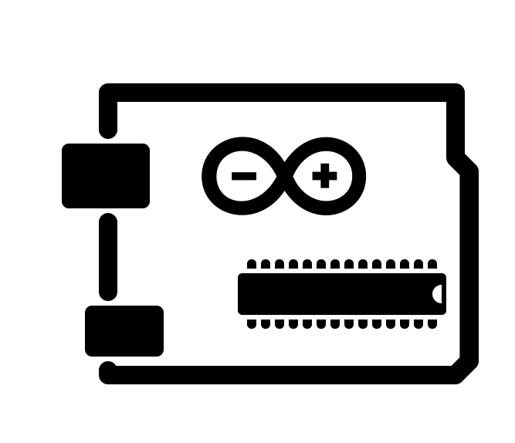
How?
System based in the Arduino Hardware
Establishing a secure connection point to point between two devices
All the security implemented in the end points.
Addressed each principle individually

Slide 5

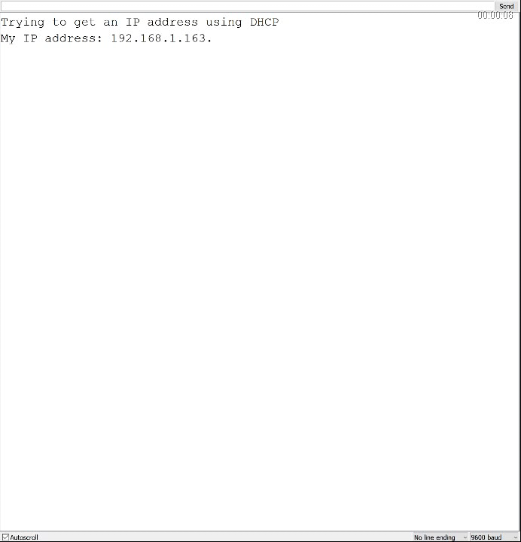

Slide 6

Confidentiality
Implemented using AES
System of private Key
Originally using mode of operation ECB (Electronic Codebook)
Implemented a Random character to improve the security

Slide 7
AES Encryption System - Rijndael
A secret key block cipher.
The AES method allows key sizes of 128, 192 and 256 bits and the encryption is made based on the key.
The algorithm consists of a certain number of encryption rounds (10 for 128 bits, 12 for 192 bits and 14 for 256 bits). Each round uses a round key, derived from the original key, going through the layers in the process.
This library was chosen based on the Arduino capacity and the algorithm complexity, in order to keep the process simple and safe.

Slide 8
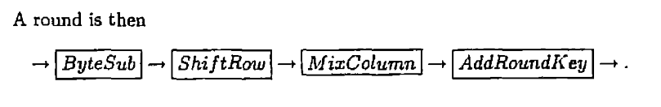
The layers:
The ByteSub Transformation (BS): This non-linear layer is for resistance to differential and linear cryptanalysis attacks.
The ShiftRow Transformation (SR): This linear mixing step causes diffusion of the bits over multiple rounds.
The MixColumn Transformation (MC): This layer has a purpose similar to ShiftRow.
AddRoundKey (ARK): The round key is XORed with the result of the above layer.

Slide 9
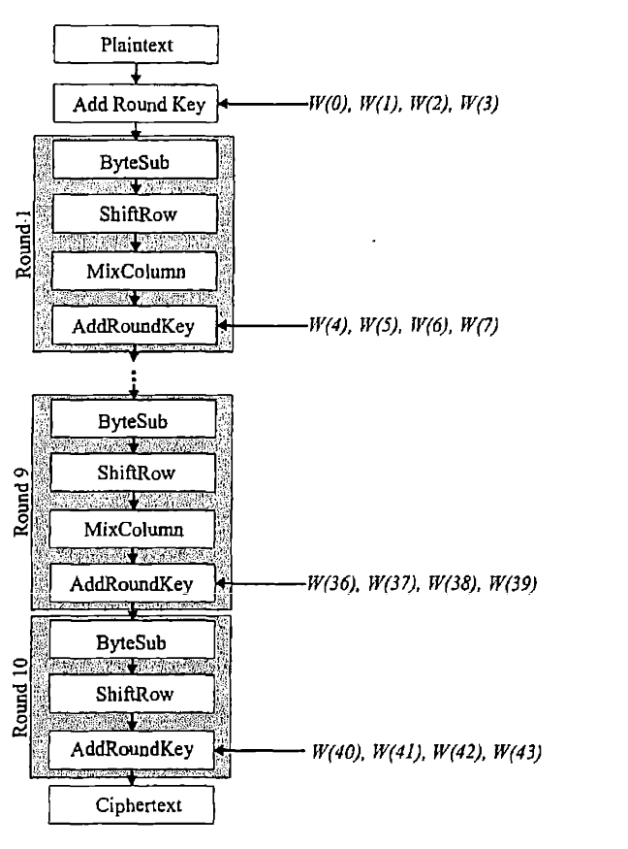

Slide 10

Integrity
Implemented using CRC (Cyclic redundancy check)
Easy to implement , reliable to use
Low memory needs
Fits well with Arduino

Slide 11
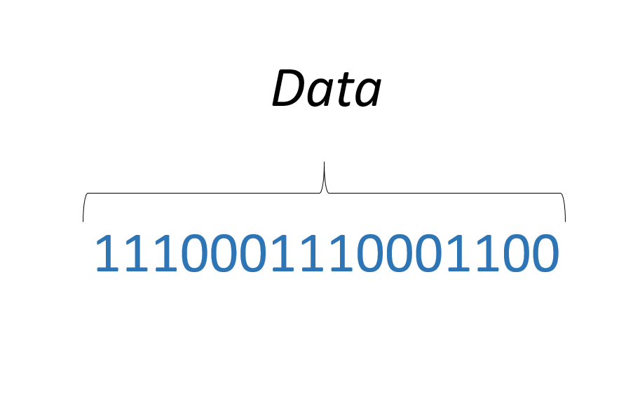
CRC

Slide 12
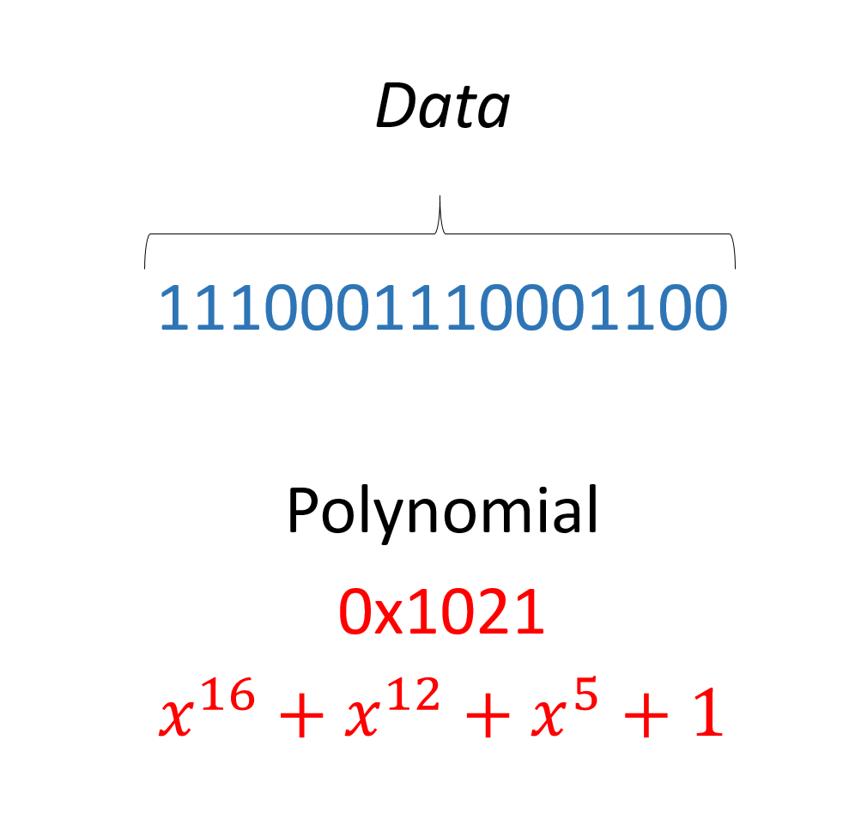
CRC

Slide 13
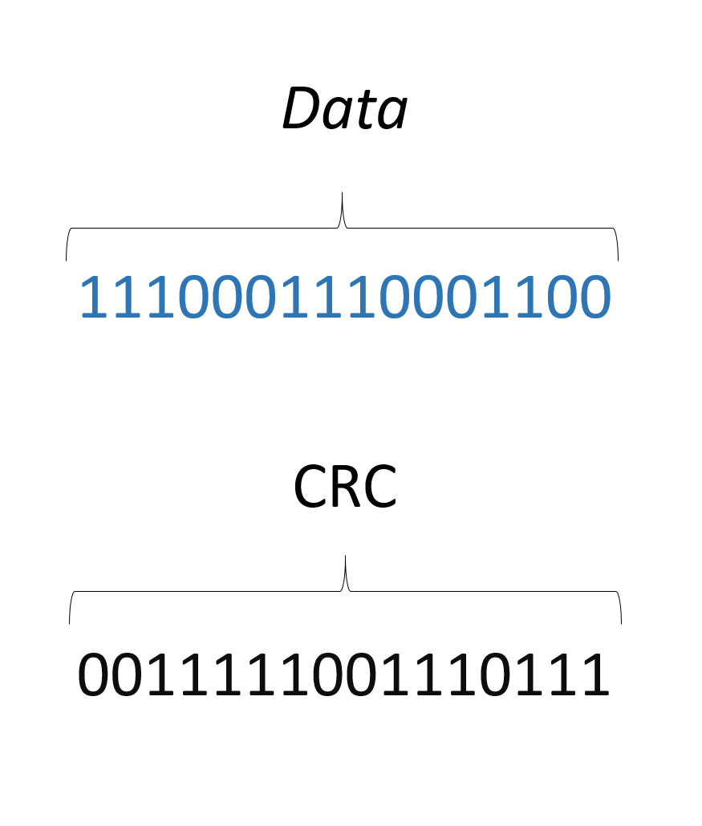
CRC

Slide 14
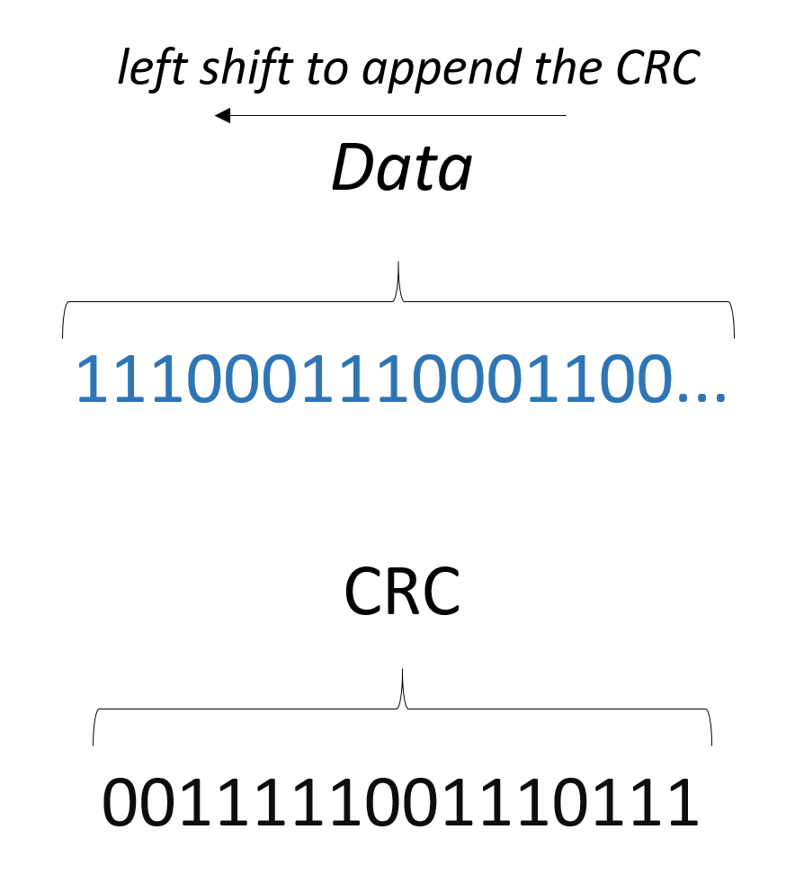
CRC

Slide 15
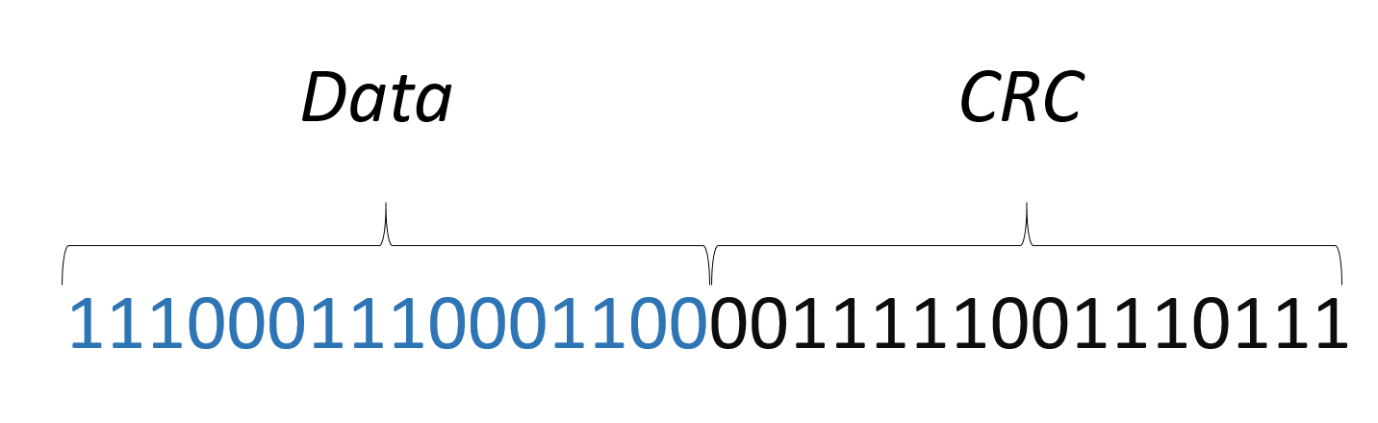
CRC

Slide 16
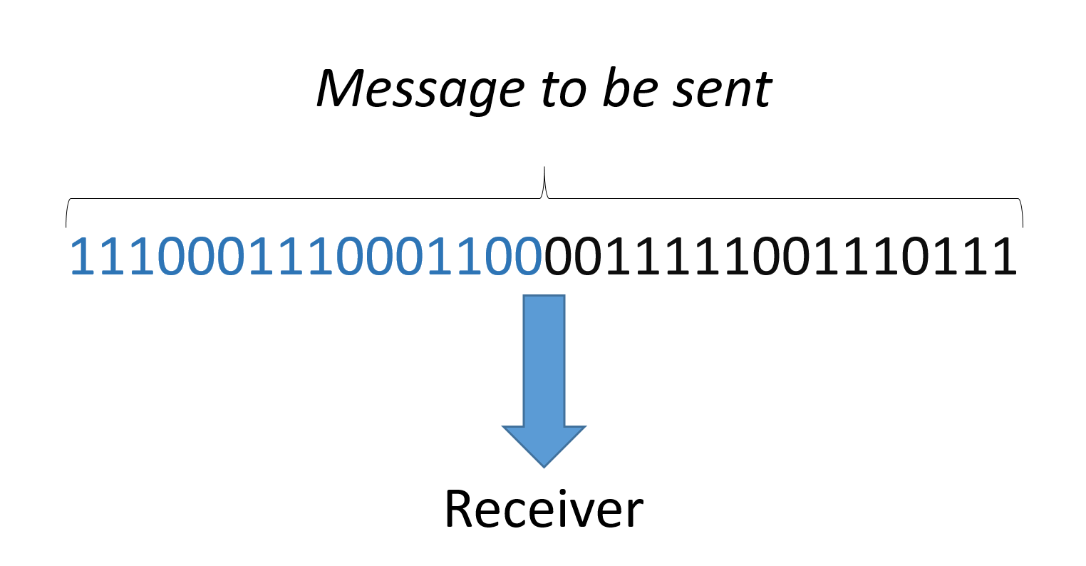
CRC

Slide 17
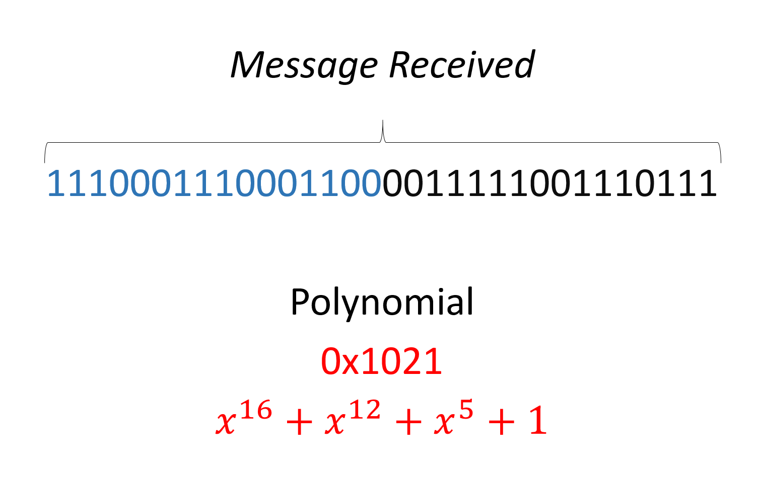
CRC

Slide 18
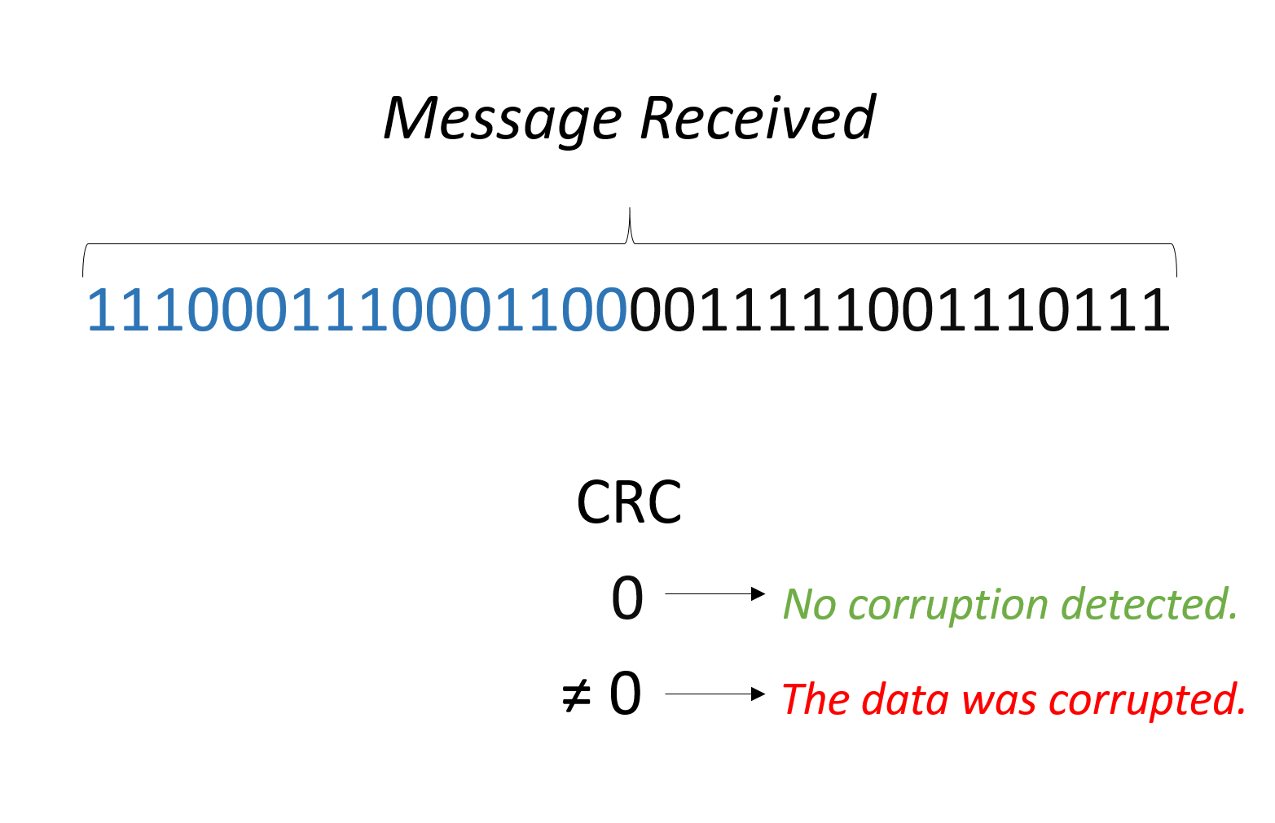
CRC

Slide 19

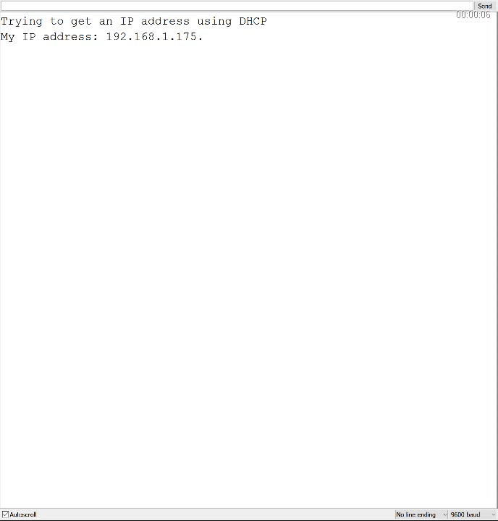

Slide 20

Authentication/ Non-repudiation
Implemented using a handshaking
Communication using a chat server/client

Slide 21

Handshaking
Each device has an unique ID
The ID is sent by the client to the server
If the ID of the client is one of the allowed the Server Treats the information
If the ID does not match the server discards the message and notify some possible attack

Slide 22

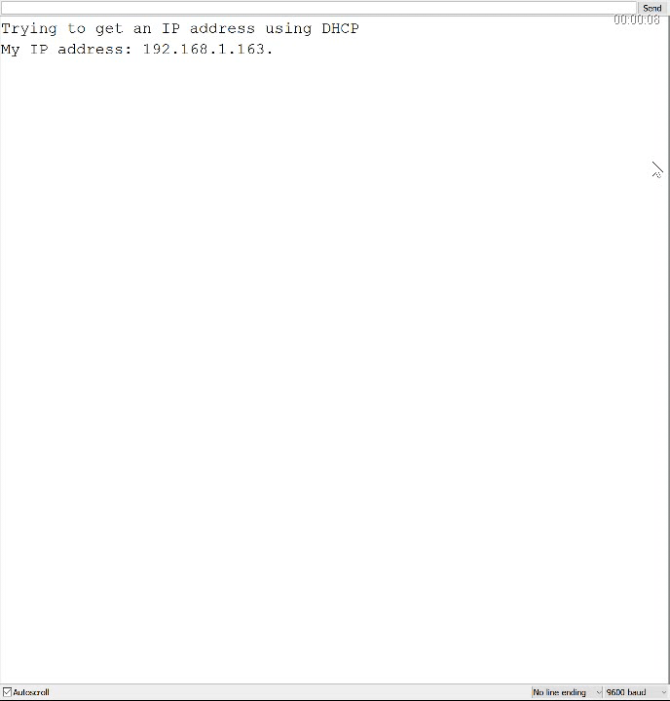

Slide 23


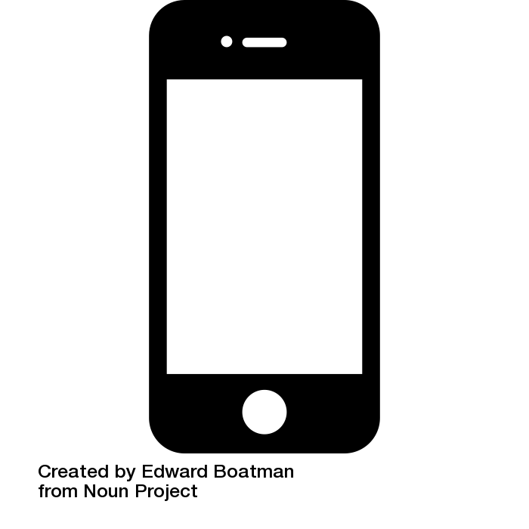
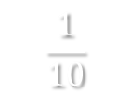
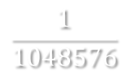

challenges
Limited memory in the Arduino Platform
Only 32KB
Use of wired instead of Wi-Fi
Low complexity handshaking
$$\frac{1}{22400}$$
$$\frac{1}{10}$$
$$\frac{1}{1048576}$$

Slide 24

To the future
Optimize the code to save more memory
Implement more security in the network to prevent external attacks

Slide 25
Thank you !

